Slide 1

Maximizing Revenue for Airbnb Properties in Chicago

Slide 2

BUSINESS PROBLEM
Assessing the interplay between occupancy rates and location

Slide 3


PROJECT OVERVIEW
Dataset Description
Welcome everyone! Today, I am thrilled to present to you an exciting journey of how I built my prediction models for the business problem of assessing the interplay between occupancy rates and geographic location in maximizing revenue for Airbnb properties in Chicago.

Slide 4

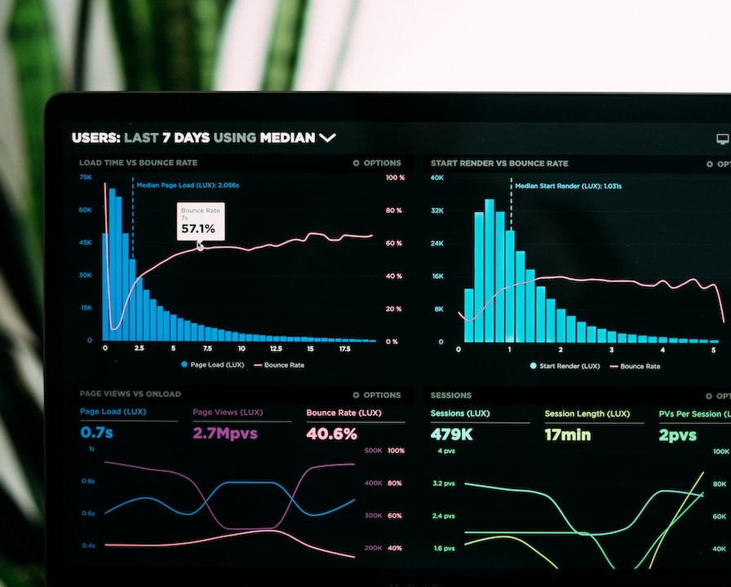
DATASET ANALYSIS
Reviewing the Airbnb dataset in Chicago
Welcome everyone! Today, I'm excited to share with you the insights and discoveries I made while building my prediction models for the Business Problem: Assessing the Interplay between Occupancy Rates and Geographic Location in Maximizing Revenue for Airbnb Properties in Chicago.

Slide 5
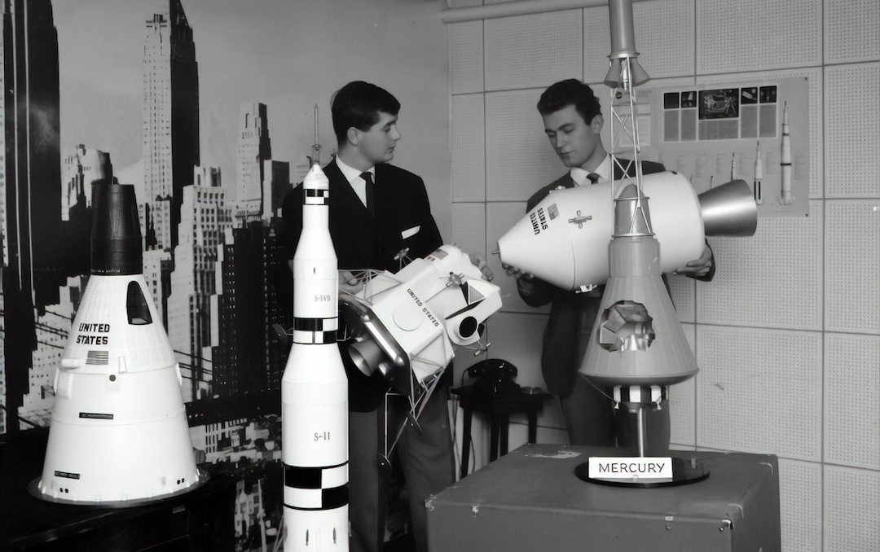



Prediction Models
RANDOM FOREST
GRADIENT BOOSTING
K-NEAREST NEIGHBORS
OVERVIEW
Ensemble learning algorithm for classification and regression
Iteratively building an ensemble of weak models
Instance-based learning algorithm for classification and regression
Models built: Random Forest, Gradient Boosting, K-Nearest Neighbors

Slide 6

RANDOM FOREST
Details and Insights
In this presentation, I will showcase how I developed my prediction models for the business problem of assessing the interplay between occupancy rates and geographic location in maximizing revenue for Airbnb properties in Chicago. The dataset used is the Airbnb dataset specific to Chicago.

Slide 7
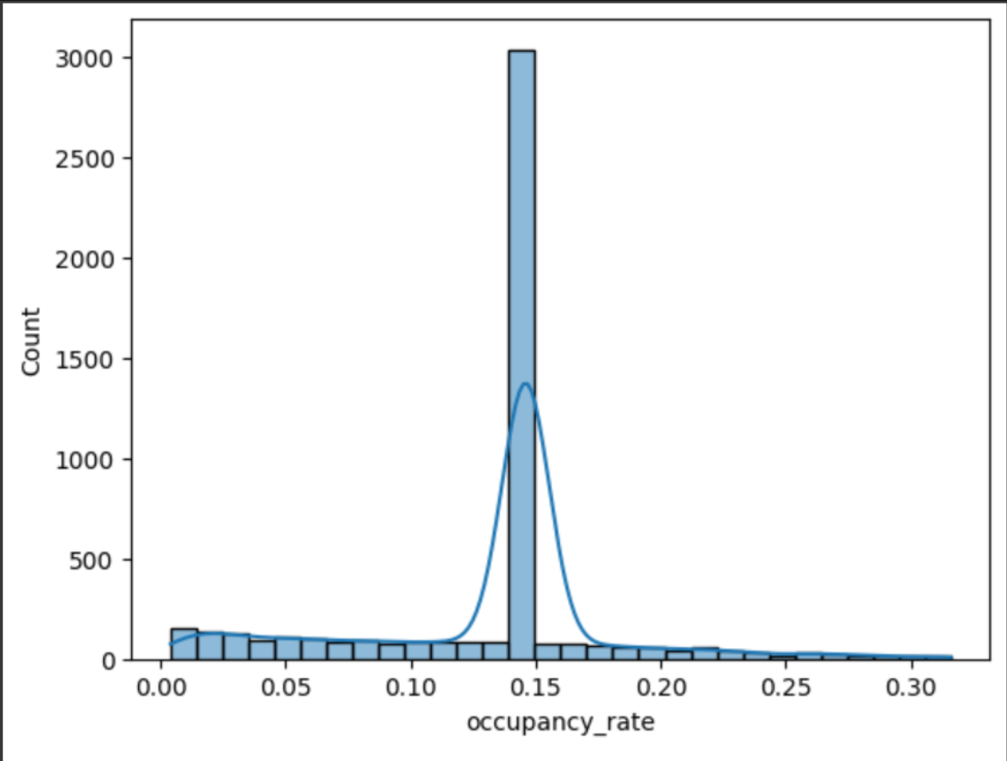
Most Listings are Rarely Booked

Slide 8
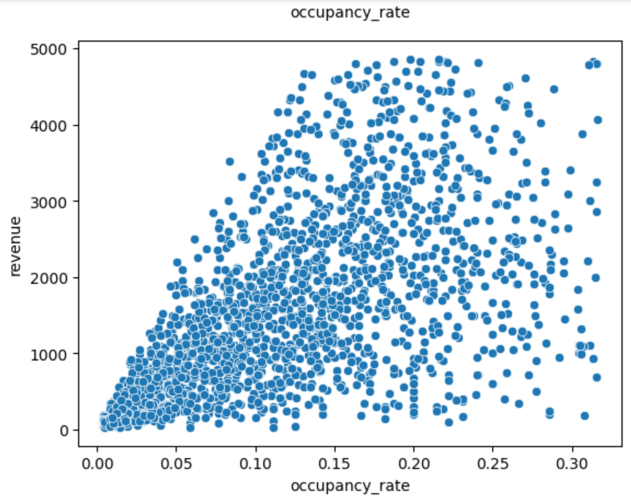
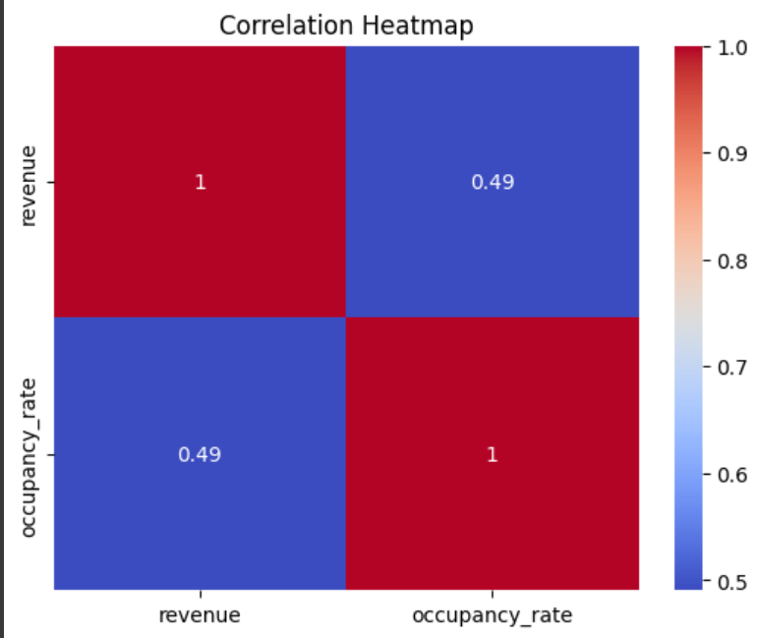
Revenue and Occupancy_rate are positively correlated

Slide 9
Model Building: A Random Forest Model with R-square Value 88.9%
is built which signifies that the Model is Robust

Slide 10
the supply of airbnb's has surged out of control, way more than demand. certain markets, causing revenue to go down substantially, particularly for mom and pop airbnb owners without access to fancy pricing tools the big guys do. i'm talking with owners around america, their listing is doing 40% less revenue this year compared to last year.
K-NEAREST
Neighbors Model

Slide 11


PROJECT WORK
Overview of the project work done in college
In this professional presentation, I will showcase the project work I undertook during my time in college. The focus was on building prediction models to assess the interplay between occupancy rates and geographic location in maximizing revenue for Airbnb properties in Chicago.

Slide 12
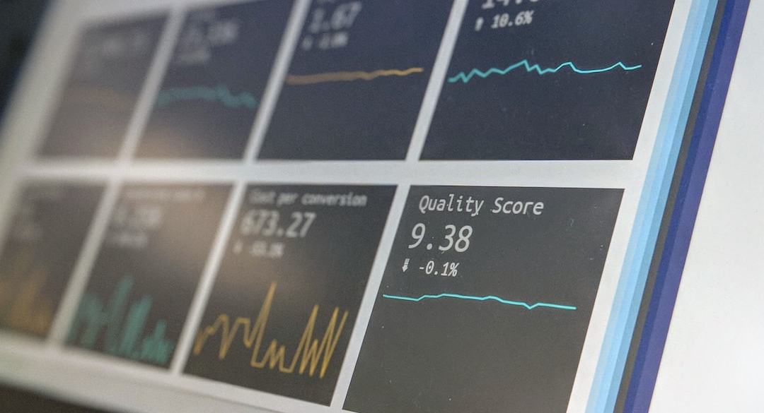

Analysis Results
MODEL INSIGHTS
GRADIENT BOOSTING
K-NEAREST NEIGHBORS
Random Forest: High accuracy and feature importance.
Local pattern recognition for accurate predictions.
Optimal balance between bias and variance.

Slide 13
PROJECT WORK
Overview of the project work done in college
In this professional presentation, I will showcase the project work I undertook during my time in college. The focus was on building prediction models to assess the interplay between occupancy rates and geographic location in maximizing revenue for Airbnb properties in Chicago.

Slide 14
CONCLUSION
Summary and key takeaways

